Slide 1


Chapter 1:
Introduction

Slide 2

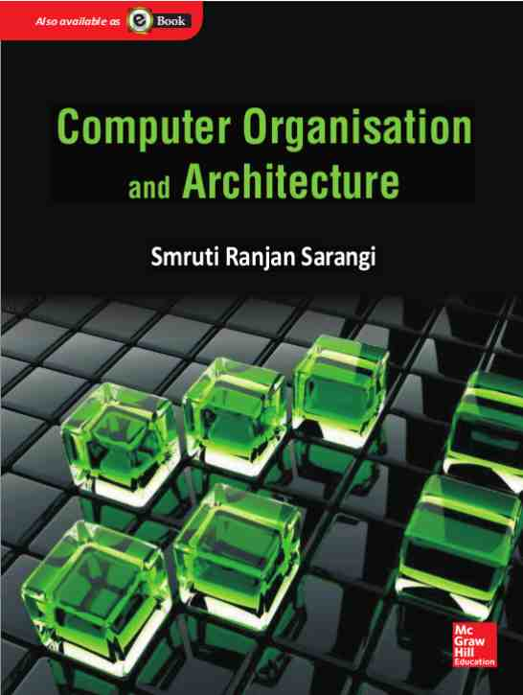
Background Required to Understand this Book
Assembly Languages
Basic Processor Design
Basic Pipeline Design
http://www.cse.iitd.ac.in/~srsarangi/archbooksoft.html

Slide 3

The Moore’s Law has Ended
1000000000000
10000000000
100000000
1000000
Number of transistors per chip (log scale)
10000
100
1
Year
1972
1982
1993
1998
2001
2004
2006
2013
2015
1971
1979
1989
1995
2000
2003
2005
2009
1974
1985
1999
2002
2007
2014
Year
Till roughly 2015, the number of transistors per chip was increasing exponentially.

Slide 4



Moore’s Law and Dennard Scaling
Moore’s Law
The number of transistors per chip will double roughly every 1-2 years. By 2023 this trend will altogether stop.
Dennard Scaling
The power-density remains constant.
The performance per Watt increases exponentially (tracking Moore’s law).

Slide 5
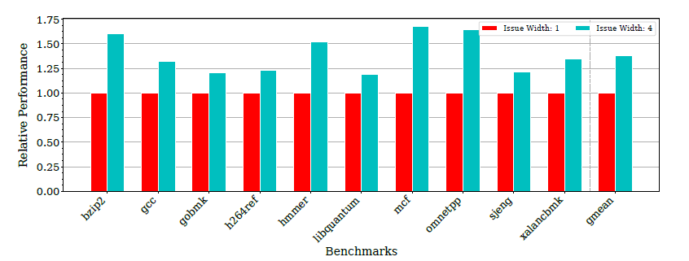

Our Journey so Far …
Increase the issue width of our regular 5-stage in-order pipelines
20-50% increase in performance

Slide 6
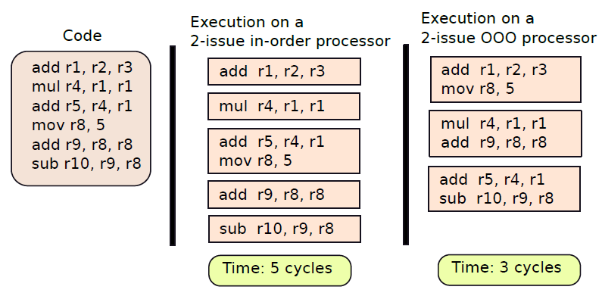
Move from In-order to OOO Processors
Execute instructions out of order (not in program order)

Slide 7
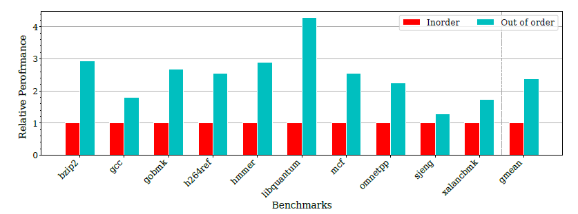
Transition from In-order to Out-of-Order
2-4X increase in performance

Slide 8
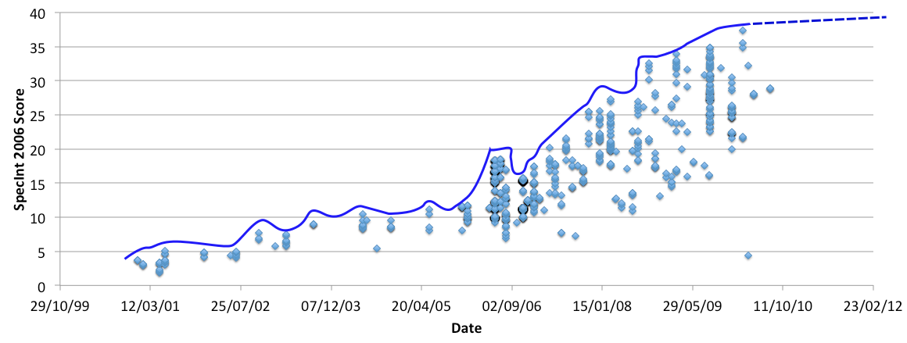
Single Core Performance Saturated
From single cores we started moving to multiple cores

Slide 9
We did not stop there …
Multiple cores
GPUs
Single cores
Multiple cores + accelerators
The 2010-20 decade belonged to multicore processors.
GPUs were repurposed to execute general-purpose programs

Slide 10
Need for a High-Performance Memory System
The memory system has become immensely complicated
There are elaborate protocols for optimizing the access time of on-chip caches
We need an elaborate on-chip network
Cache design
On-chip Networks
Theory of Multiprocessor Systems
Main Memory and Nonvolatile Memory

Slide 11





Assorted Issues
Power and temperature are major issues.
Reliability: transient faults and hard errors.
Parameter variation: variations in the process, voltage, and temperature
Security

Slide 12

Architectures for Machine Learning
This is the future.
Dedicated on-chip accelerators for accelerating computer vision, machine learning and speech processing.

Slide 13
The End

